Slide 1

GWAS Analysis
Methodologies & tools

Slide 2
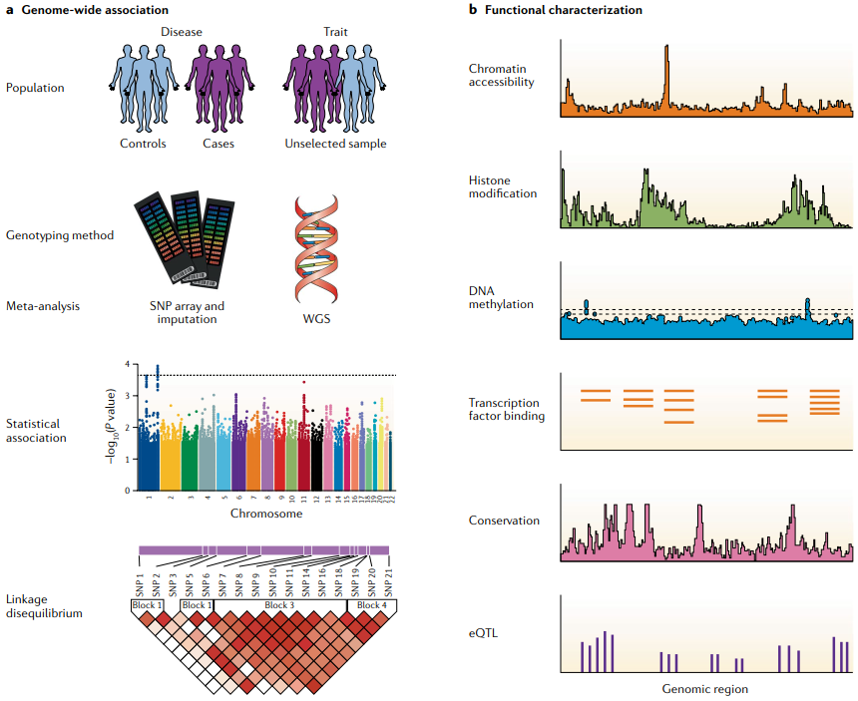
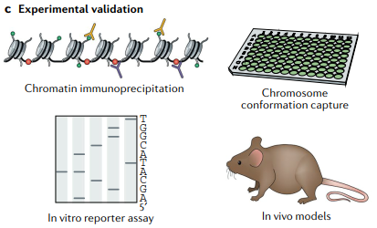
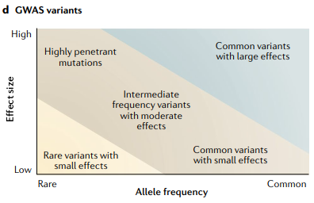
GWAS design
⑪ CHIP
⑫ 3C↑
⑤
⑥
①
⑦
②
⑬
⑭
⑧TF
⑮
③
⑨
④LD
⑩√
Source: Tam V, et al. Benefits and limitations of genome-wide association studies. Nat Rev Genet. 2019 Aug;20(8):467-484.

Slide 3
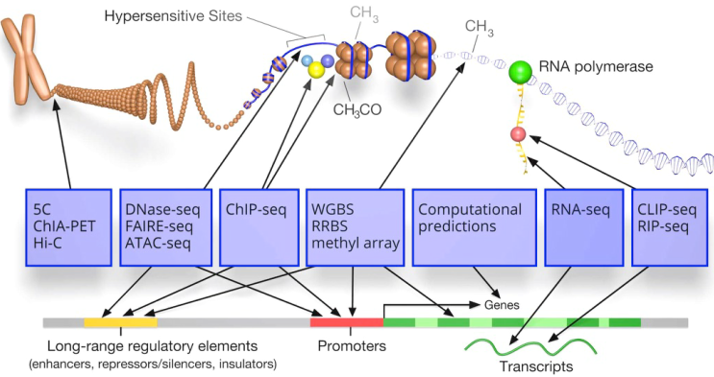
NGS techniques
Biochemistry
√
√
√
√
√
Techniques
Genomic features
Reference: https://www.encodeproject.org/

Slide 4
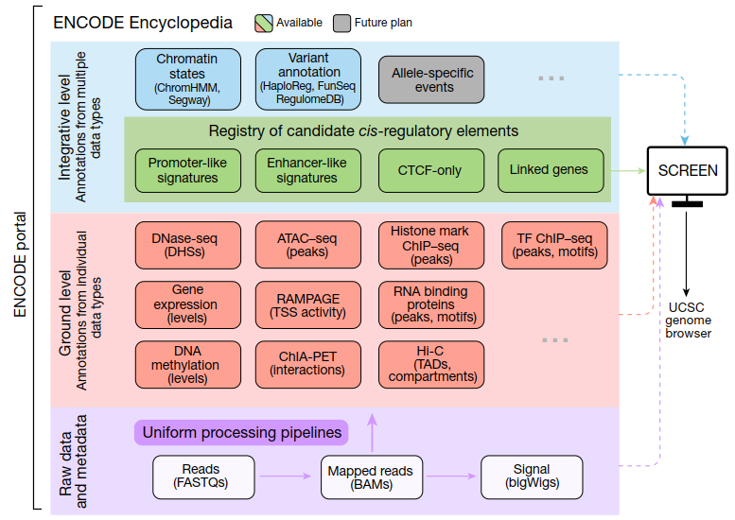
Example : ENCODE Encyclopedia
Source: Jill E Moore, et al. Expanded encyclopaedias of DNA elements in the human and mouse genomes. Nature. 2020 Jul;583(7818):699-710.

Slide 5
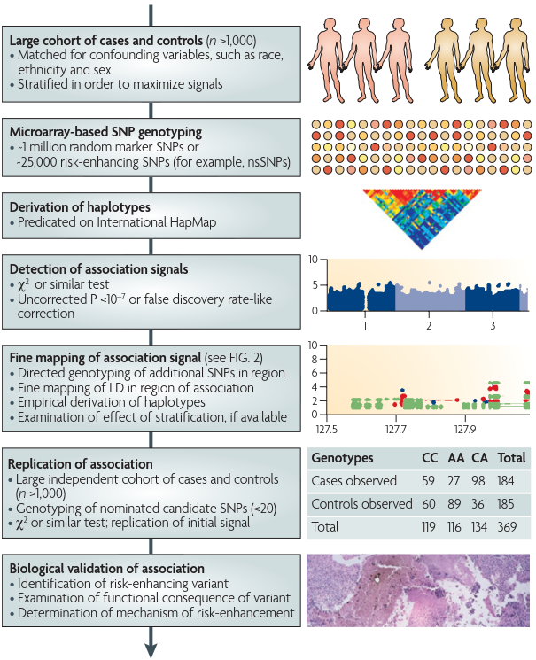
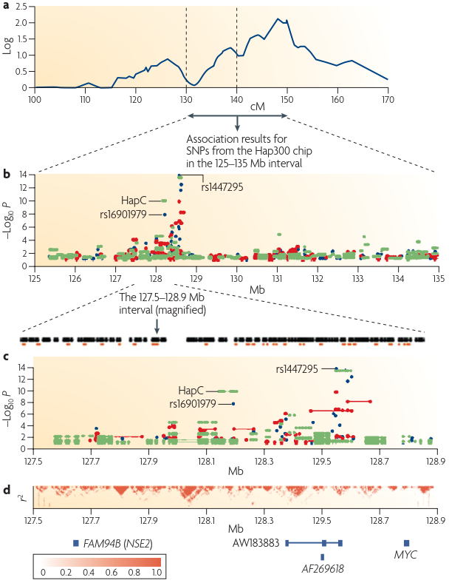
Workflow¹
Source: Stephen F Kingsmore, et al. Nat Rev Drug Discov. 2008 Mar;7(3):221-30.

Slide 6
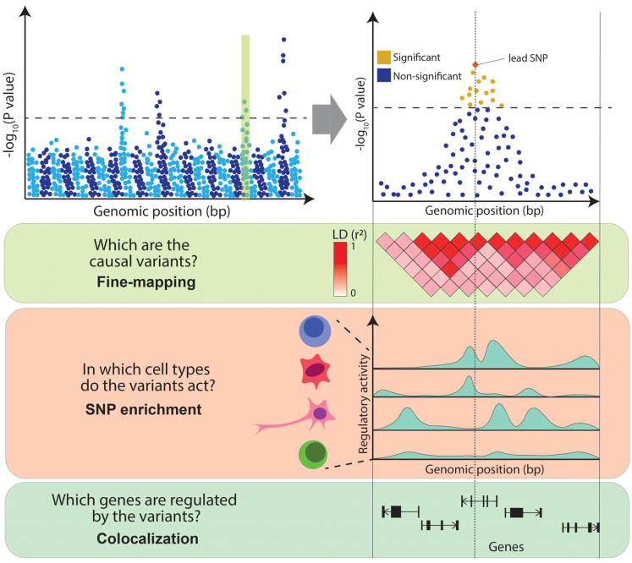
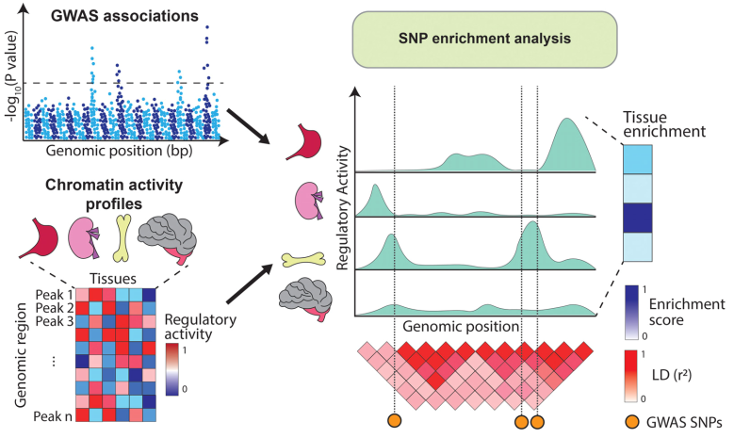
Workflow²
Source: Eddie Cano-Gamez, Gosia Trynka. Front Genet. 2020 May 13;11:424.

Slide 7
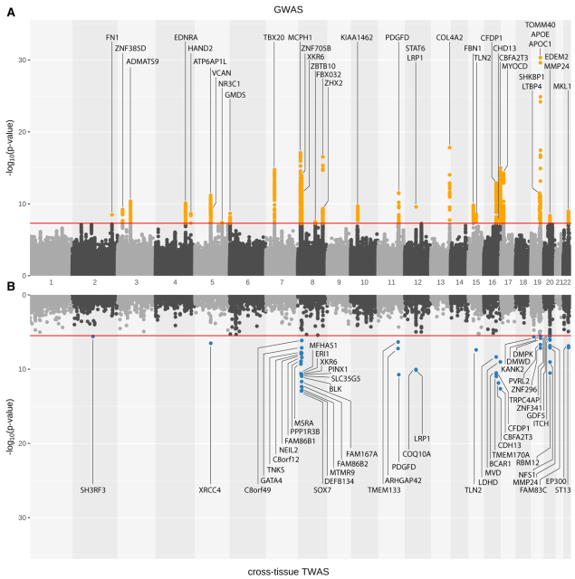
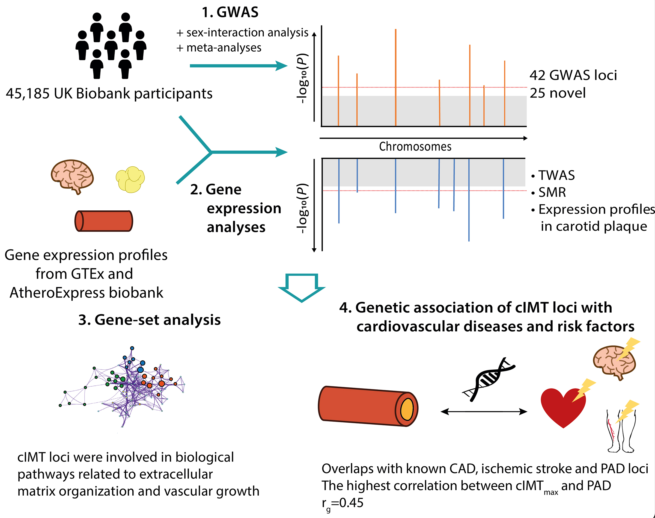
Workflow³
eQTL analysis
Source: Ming Wai Yeung, et al. Arterioscler Thromb Vasc Biol. 2022 Apr;42(4):484-501.

Slide 8
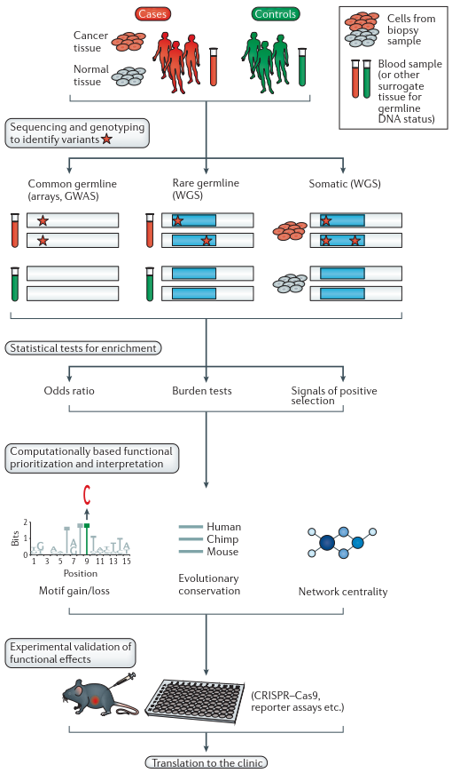
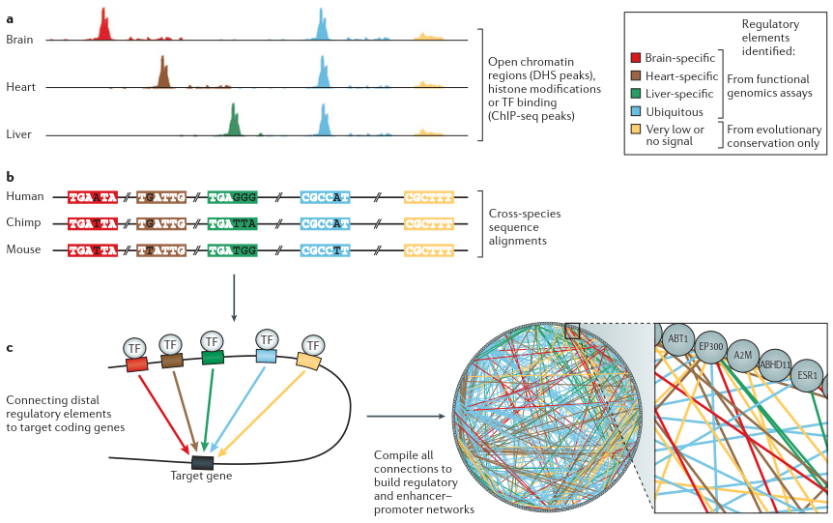
Workflow⁴
Source: Ekta Khurana, et al. Role of non-coding sequence variants in cancer Nat Rev Genet. 2016 Feb;17(2):93-108.

Slide 9
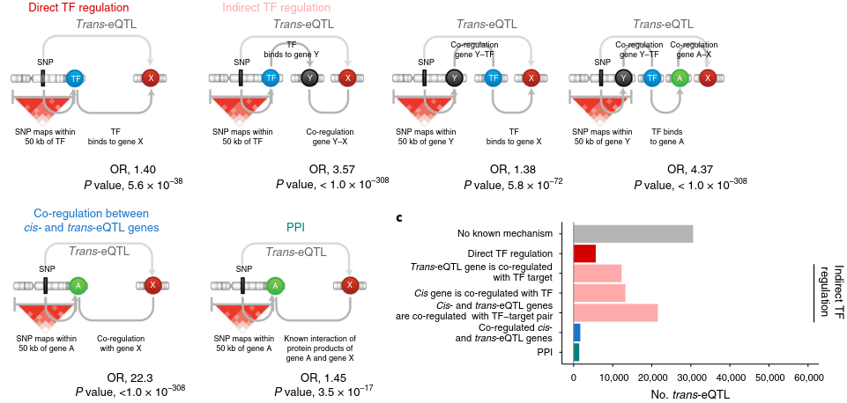
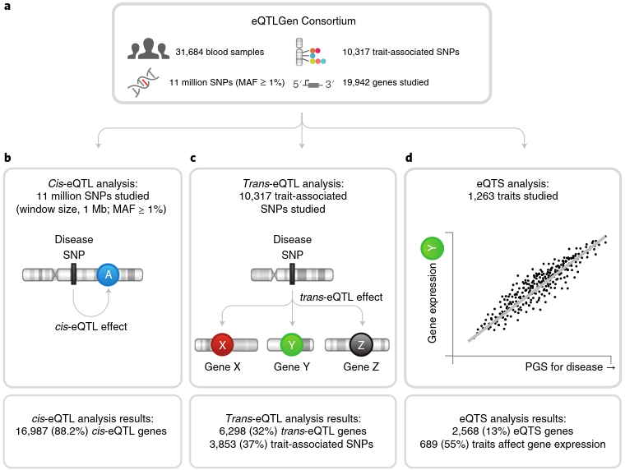
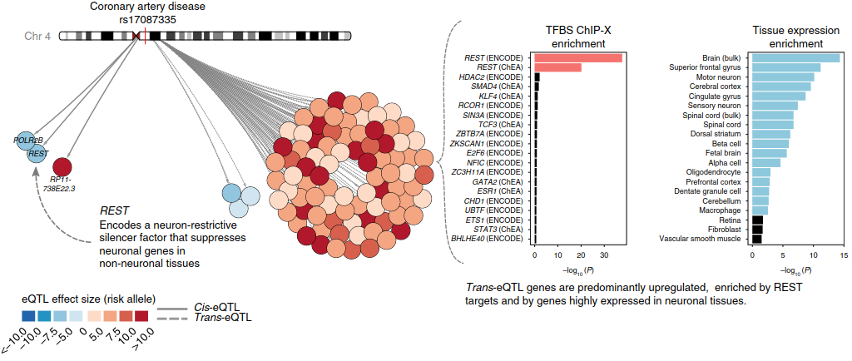
Workflow⁵
Source: Urmo Võsa, et al. Nat Genet. 2021 Sep;53(9):1300-1310.

Slide 10

未 來 展 望
Core
Functional genome
Functional characterization
Combining Pathway → multi-omics
Combining CRISPR → Gene therapy

Slide 11
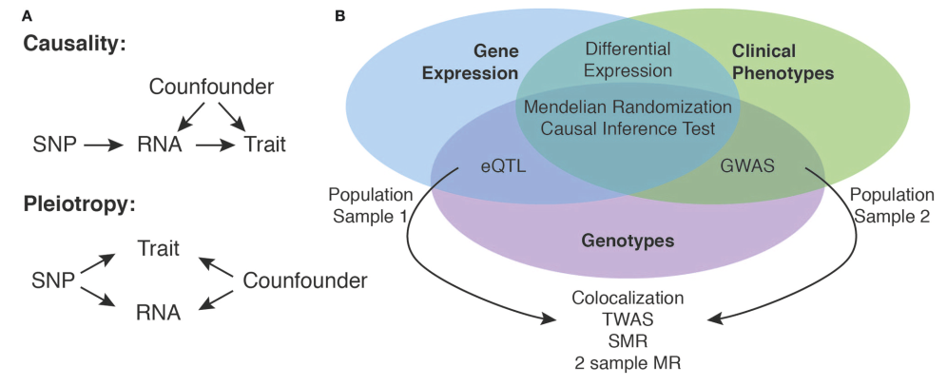
Research in the future¹
Source: Matthias Heinig. Using Gene Expression to Annotate Cardiovascular GWAS Loci. Front Cardiovasc Med. 2018 Jun 5;5:59.

Slide 12
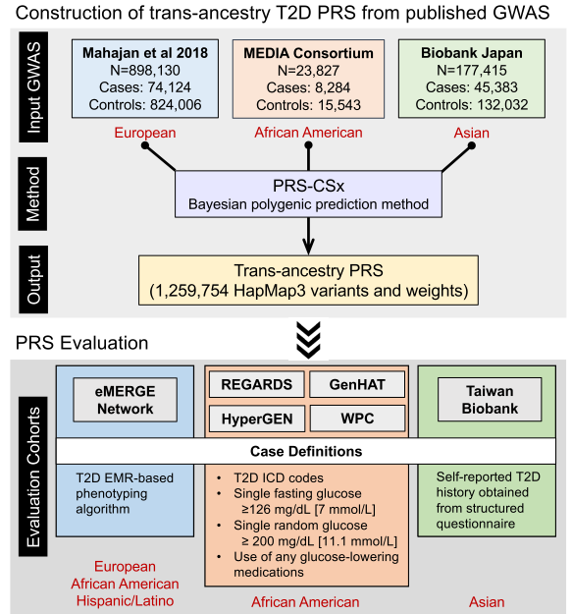
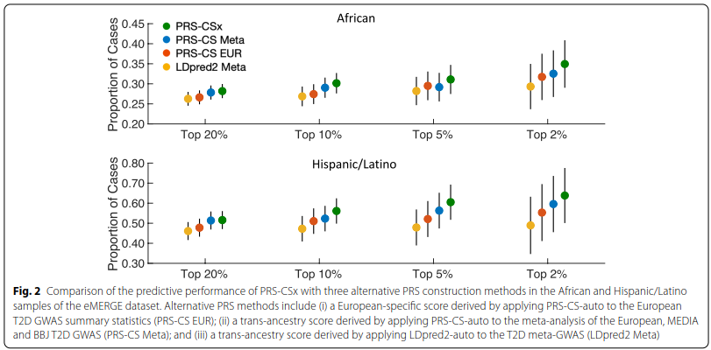
Research in the future²
Source: Ge et al. Development and validation of a trans-ancestry polygenic risk score for type 2 diabetes in diverse populations. Genome Med. 2022 Jun 29;14(1):70.

Slide 13
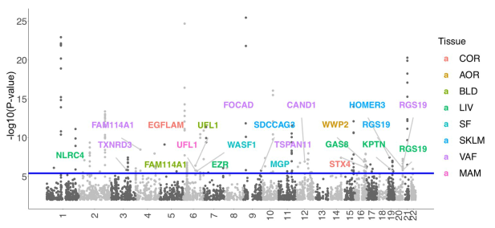
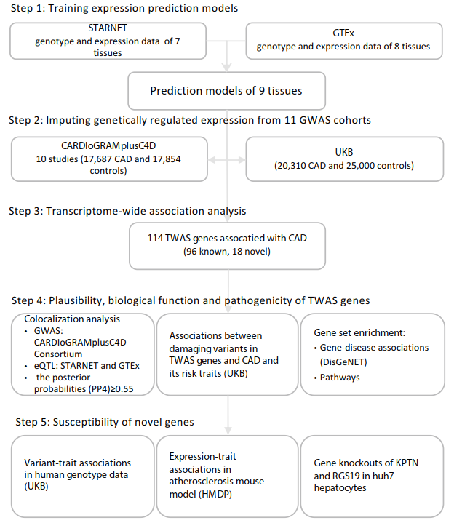
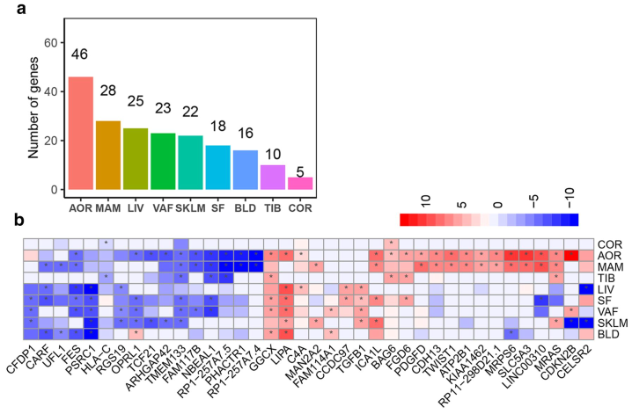
Research in the future³
Source: Ling Li, et al. Transcriptome‑wide association study of coronary artery disease identifies novel susceptibility genes. Basic Res Cardiol. 2022 Feb 17;117(1):6.

Slide 14
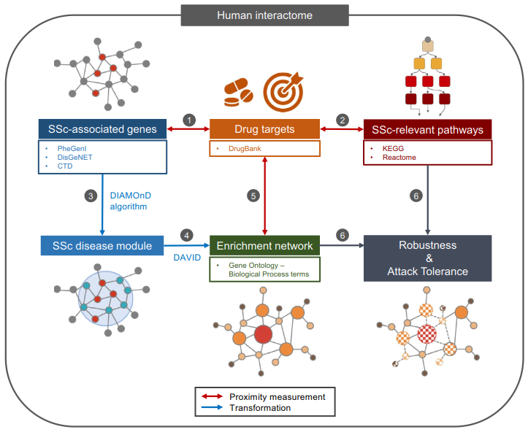
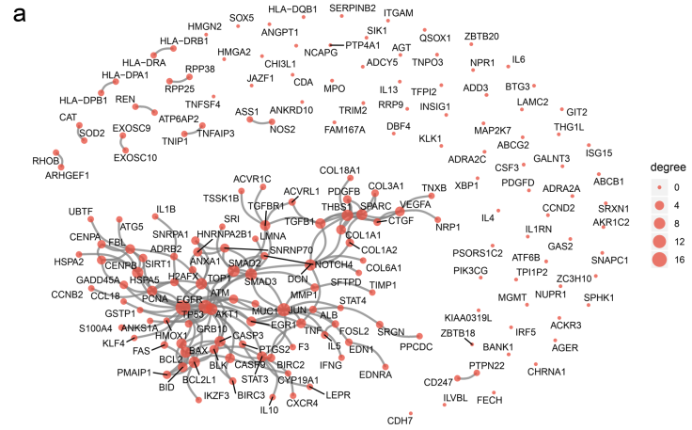
Research in the future⁴ – drug discovery
Source: Ki-Jo Kim, et al. Network-based modeling of drug effects on disease module in systemic sclerosis. Sci Rep. 2020 Aug 7;10(1):13393.

Slide 15
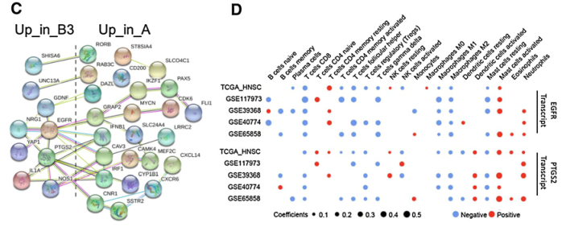
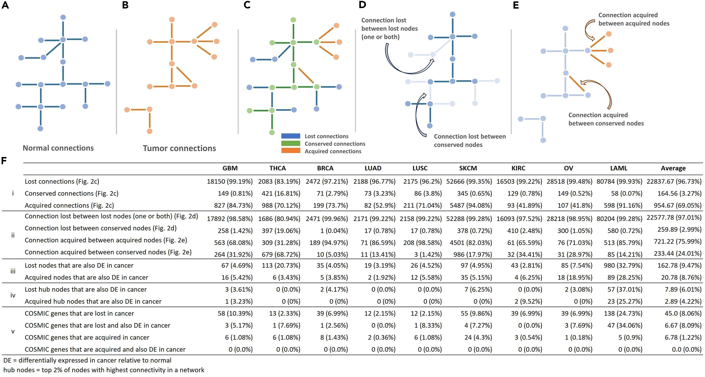
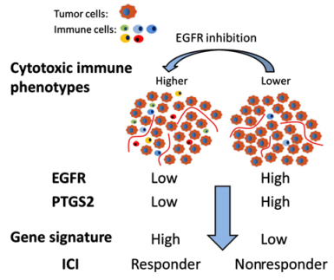
Research in the future⁵ – gene therapy
Source: Zainab Arshad, John F McDonald. iScience. 2021 Nov 26;24(12):103522.
Source: Bohai Feng, et al. lin Cancer Res (2020) 26 (14): 3616–3628.

Slide 16
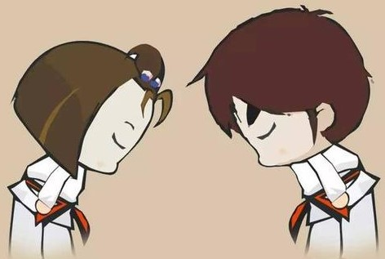
Thanks for your Attention

